Slide 1
Introduction to Human Computer Interaction
A USER INTERFACE IS LIKE A JOKE. IF YOU HAVE TO EXPLAIN IT, IT’S NOT THAT GOOD
Lauren Bricker
bricker@cs.washington.edu
As you come into class
In pairs work on the “Determine the User” side of the worksheet
If you get done work on the Critiquing Designs side of the worksheet
source: https://twitter.com/iconfinder/status/472014218267742208
Notes:
5 minutes: Start with Exercise: https://docs.google.com/document/d/1X0qwGigSXa1hq6Q6dws3PxHryGhEyCgkaEHyJCMgvj4/edit

Slide 2
Share out
Which Teapots did you choose for "Someone who needs to serve tea at dinner party?" Why did you choose those particular teapots?
Which teapots did you choose for "Someone who likes metallic objects?" Why did you choose those particular teapots?
Which users were the easiest to find matches for?
Which users were the hardest to find matches for?
On page 2 (if you got to it), ask which teapot was your favorite? Why?

Slide 3
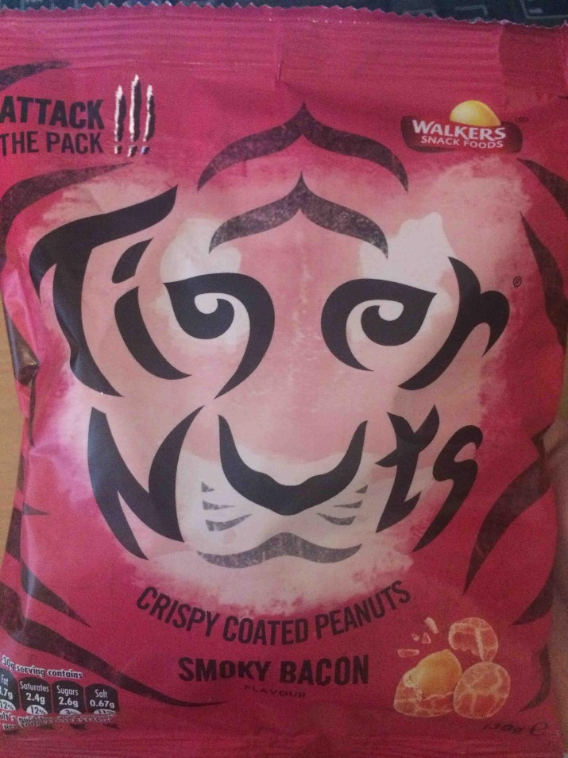
Impressions?
What is interesting about this graphic?
How do you feel when you see it?
Other famous logos that have a hidden message

Slide 4
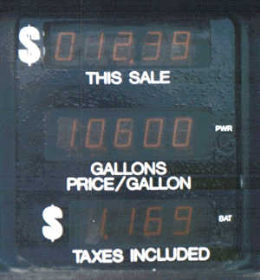
Impressions?
Hard to distinguish cost vs. # gallons
bad labels
placed inconsistently
displays too similar
From James Landay
Notes:
So why is this important? Let’s take this simple example.

Slide 5
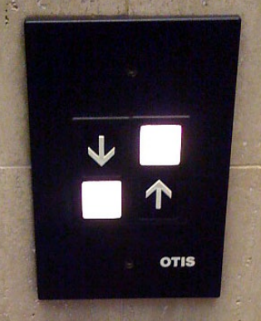
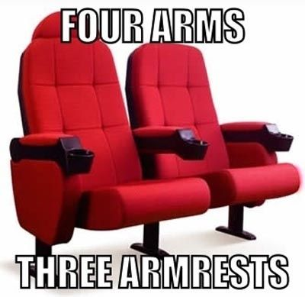
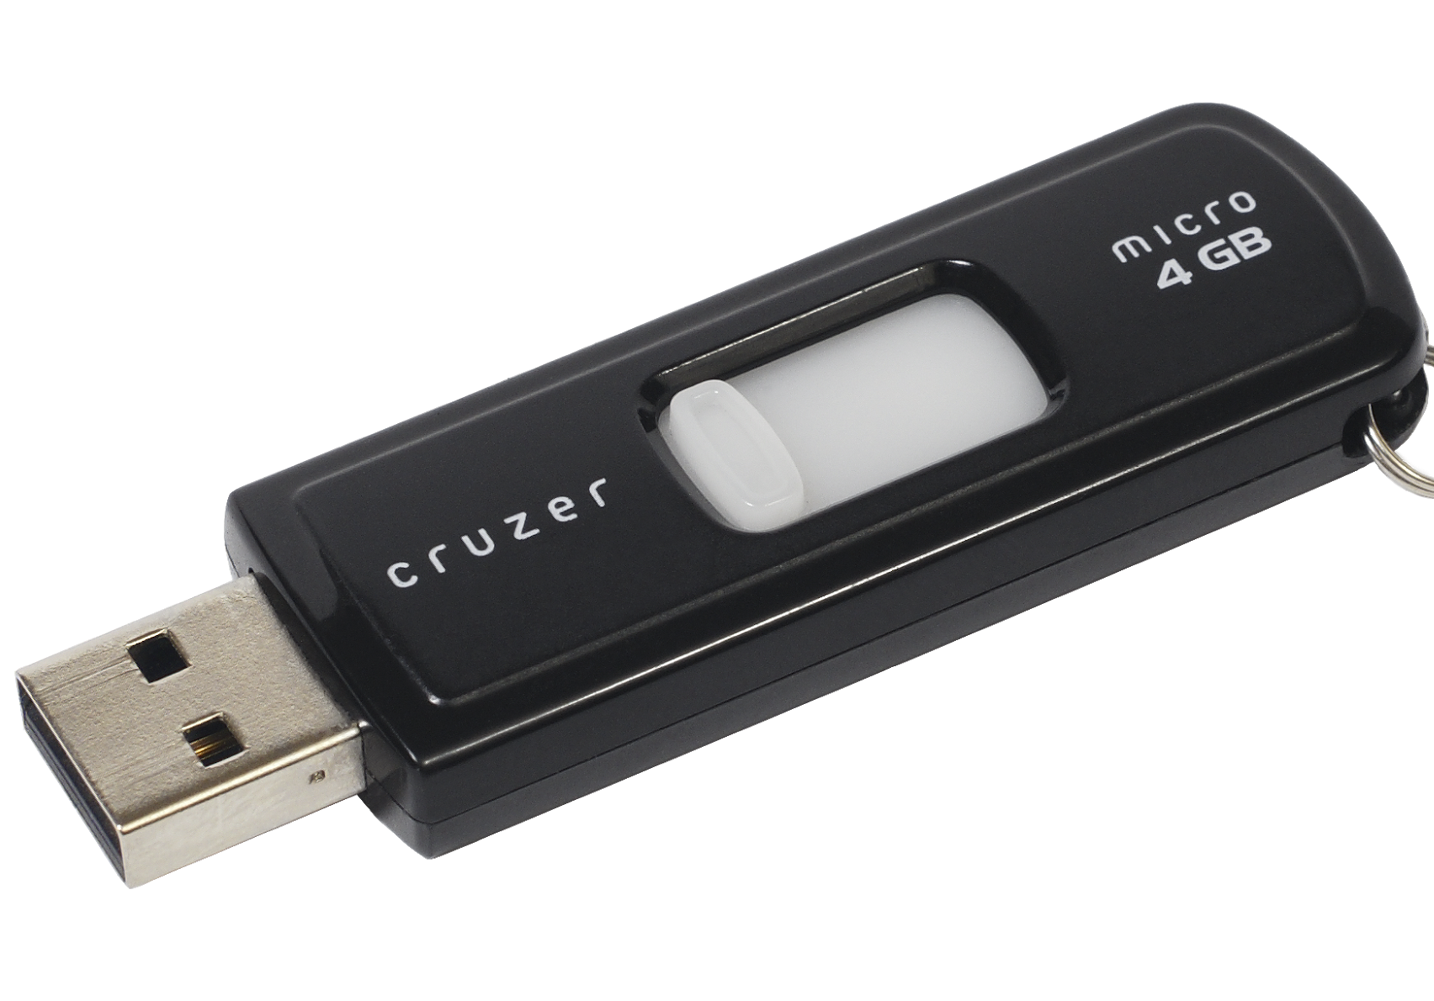
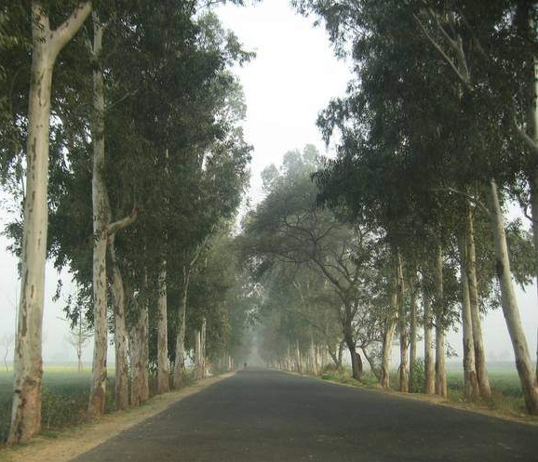
Impressions?
Sources: Elevator, Chair, USB Disk, Tree lined street
Lots of other examples of bad design not shown here: https://www.quora.com/What-are-some-examples-of-bad-design-you-have-seen
S
Notes:
The first three may be fairly obvious. The last one is an example of a tree lined street, which is environmentally wonderful, beautiful and can evoke strong positive feelings. But driving down a street like this on a bright day can be problematic if you go in and out of the shade. Trees this close to the road can also drop leaves, seeds and other matter directly on the road, causing hazards, particularly in wet weather. And trees this close to the road could potentially fall over the road during storms.

Slide 6
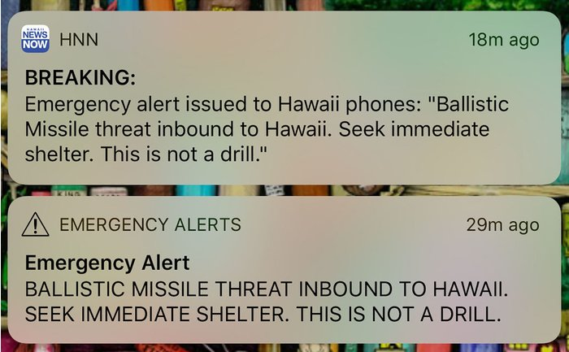
Impressions?
https://imagesvc.timeincapp.com/v3/mm/image?url=https%3A%2F%2Ftimedotcom.files.wordpress.com%2F2018%2F01%2Fhawaii-missile-alert.jpg&w=700&q=85
Notes:
How imagine this shows up on your phone.
It took them 38 minutes before they could send out a subsequent wireless alert saying it was a mistake.

Slide 7
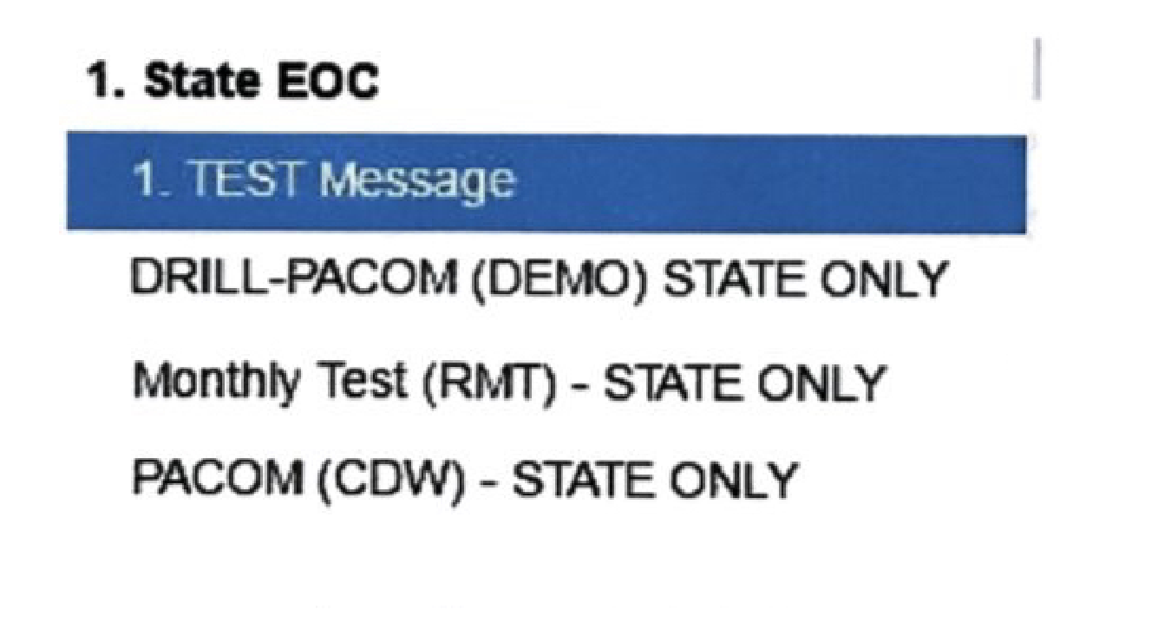
https://www.extremetech.com/extreme/262166-hawaiis-missile-scare-driven-terrible-ui-fcc-launches-investigation
Notes:
Hawaii Gov. David Ige told CNN that human error caused the alert to go out.
"It was a mistake made during a standard procedure at the change over of a shift, and an employee pushed the wrong button," he said.
This is a mock up of what the UI looks like (modified to show what it looked like originally) – they have not released the real UI for “security concern”

Slide 8
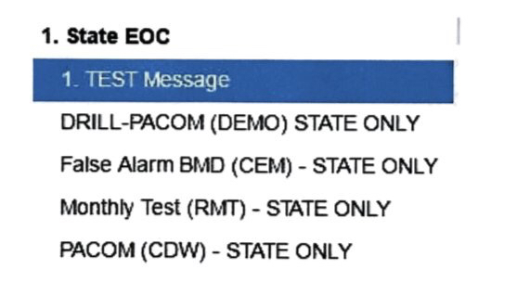
More disasters caused by bad user interfaces
https://www.extremetech.com/extreme/262166-hawaiis-missile-scare-driven-terrible-ui-fcc-launches-investigation
Notes:
They’ve since added the False Alarm.
Personal story: @Lakeside. Lockdown drill that said “this is not a drill”

Slide 9
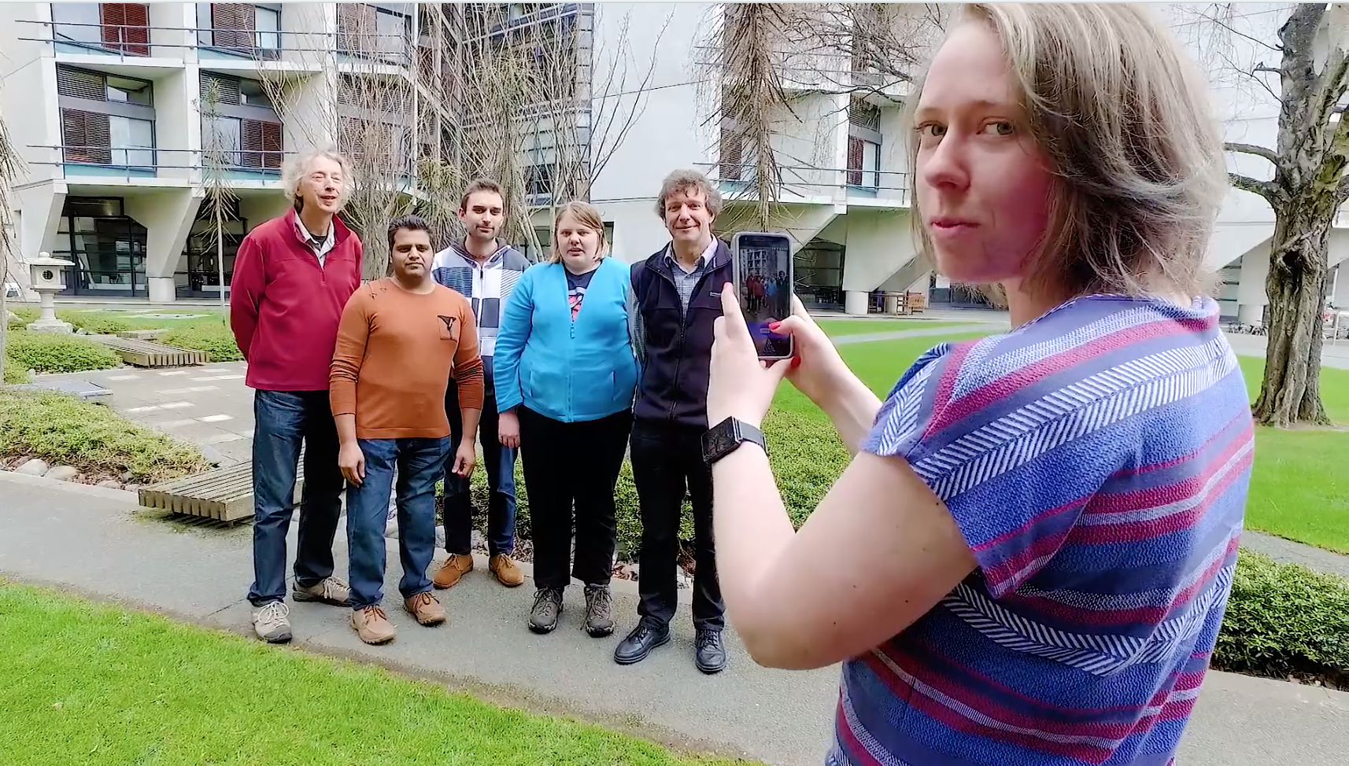
From: http://csfieldguide.org.nz/en/chapters/human-computer-interaction.html
And https://vimeo.com/186668687

Slide 10
What is HCI?

Slide 11
HCI is…
Notes:
Each discipline brings its own knowledge and
has its own priorities!

Slide 12
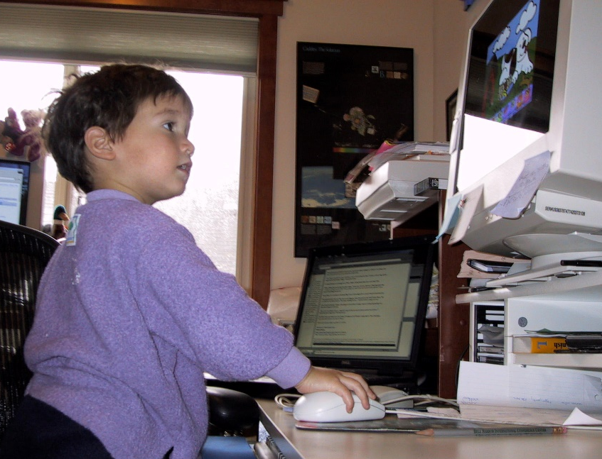
HCI is… Human-Computer Interaction
Human
The end-user or users of a program
Computer
The machine (machines or client/server), or devices the program runs on
Interaction
The user tells the computer what they want
The computer communicates results
James Landay, (ex UW-CSE, now Stanford)
Notes:
What is a computer, really?

Slide 13
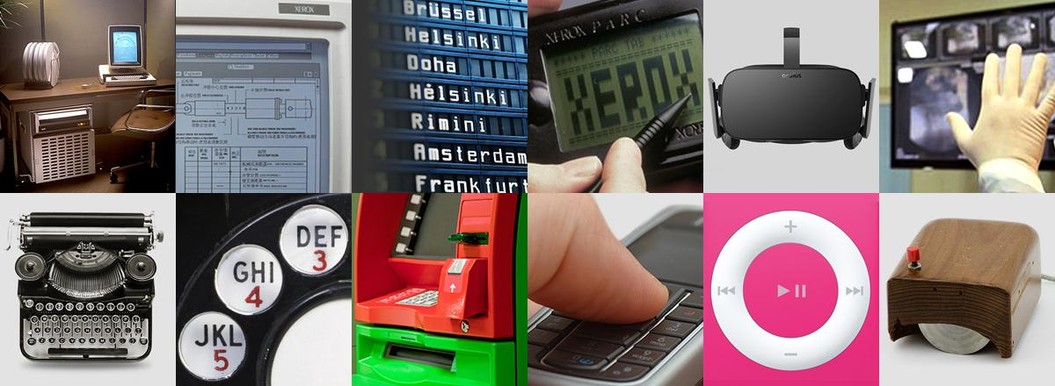
HCI is… User Interfaces (UIs)
That part of application that allows people
to interact with computer
to carry out their task
https://www.xerox.com/en-us/insights/user-interface-examples
Notes:
Interestingly: User == bad – drugs.
UI Design – designing User Interfaces.

Slide 14
HCI is… User Experiences (UX)
From Wikipedia: “ the process of enhancing user satisfaction with a product by improving the usability, accessibility, and pleasure provided in the interaction with the product”
Need to understand all three parts of the “Human-Computer-Task” triangle
Computer
Human
Task
Notes:
Unlike the conjoined triangles of success, This is the Human Computer Task triangle. Humans use computers to accomplish a task

Slide 15
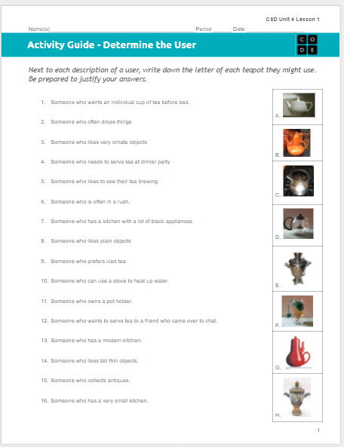
But remember
You
Are
Not
The
User
.

Slide 16
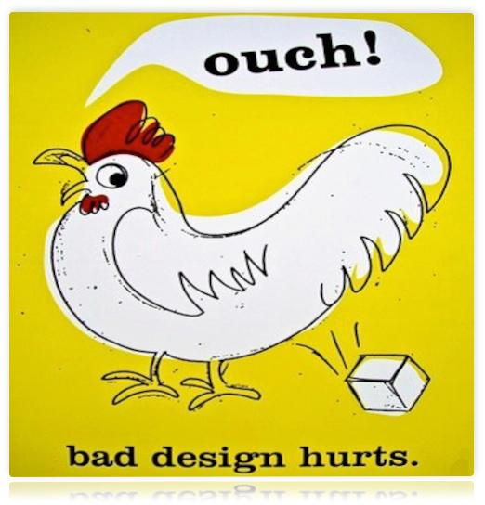
HCI is… Important
Bad user interfaces cost
money
5%↑ satisfaction → up to 85%↑profits
finding problems early makes them easier to fix
reputation of organization (e.g., brand loyalty)
lives
User Interfaces hard to get right (why?)
people are unpredictable
intuition of designers often wrong
https://i.pinimg.com/originals/a0/59/70/a059704175f2eafb7df658f2af803ccc.jpg
Notes:
To maximize profit, managers have pursued the Holy Grail of becoming number-one or -two in their industries for nearly two decades. Recently, however, new measures of service industries like software and banking suggest that customer loyalty is a more important determinant of profit. (See Frederick F. Reichheld and W. Earl Sasser, Jr., “Zero Defections: Quality Comes to Services,” HBR September–October 1990.) Reichheld and Sasser estimate that a 5% increase in customer loyalty can produce profit increases from 25% to 85%. They conclude that quality of market share, measured in terms of customer loyalty, deserves as much attention as quantity of share. - http://hbr.org/1994/03/putting-the-service-profit-chain-to-work/ar/1

Slide 17
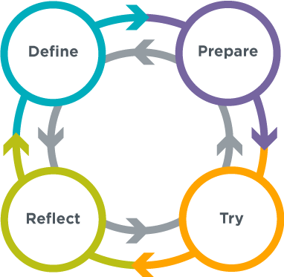
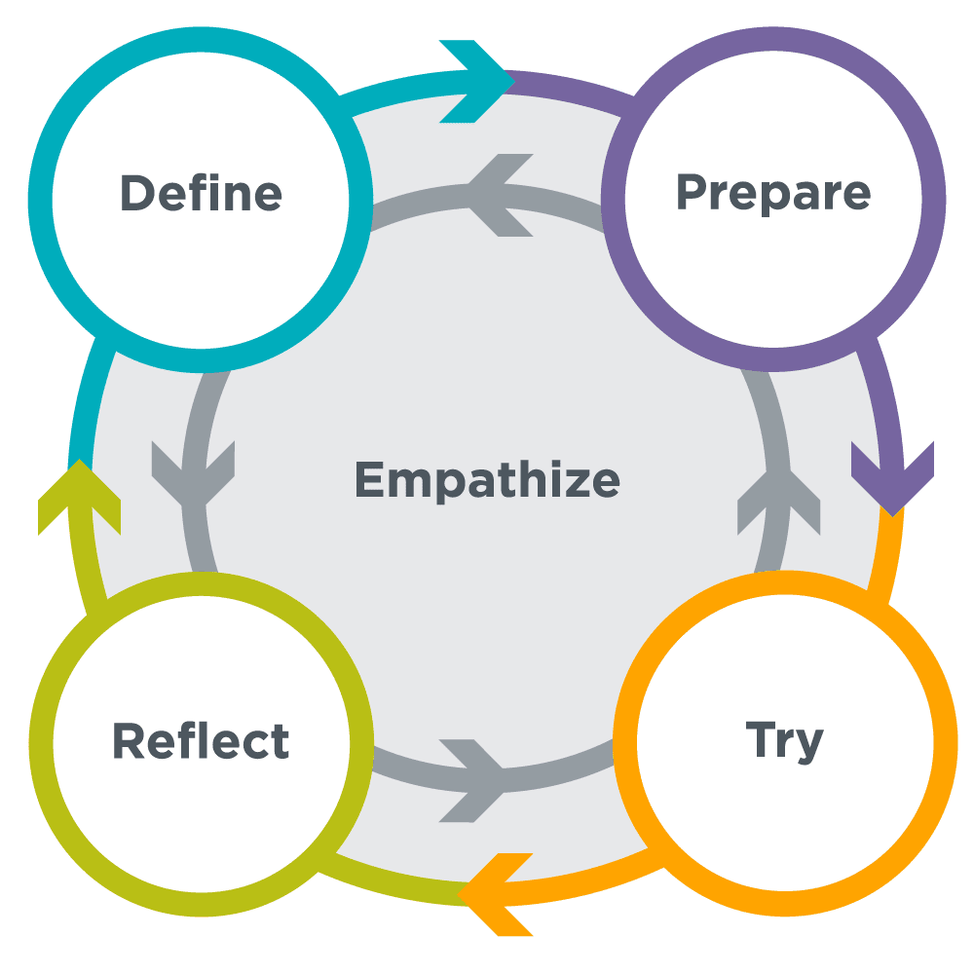
HCI is … Problem Solving with Empathy
Notes:
This is a visualization of the Problem Solving Process used with Code.Org’s CS Discoveries – the 6-9th grade curriculum I helped to develop during the summer of 2016. I spent 10 weeks over the summer designing the flow of unit 4 which is called the Design Process.
Unit 1-3 the students focus on projects based on what *they* want. Unit 4 is where we transition to thinking about design for others. “Taking design from the me to the we” as I like to say.
Define: Understanding the problem when it was assigned, examining available resources, finding problems with their original design before deciding how to fix them if there was one.
Prepare: Discussing with team members how to proceed, brainstorming approaches, anticipating possible flaws.
Try: Actually building the product and running tests
Reflect: Examining the results of their test, comparing their results to predictions

Slide 18
HCI is…Iterative
Define
Understanding the user and task and any constraints through Task Analysis, Contextual Inquiry, Ethnographic studies
Prepare
Prototypes, storyboards, use cases
Try
Test the prototypes with Participatory design – early and continuous involvement by end users
Reflect
What went right? What went wrong? What to change?
Define
Prepare
Try
Perform Contextual Inquiry, Ethnographic studies on working product
Reflect
Version 2.0…
Notes:
I’ll explain contextual inquiry and participatory design momentarily

Slide 19

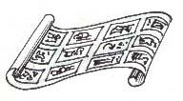
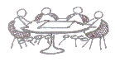
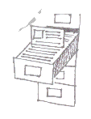



User Interface Development Process
Customers, Products,
Business, Marketing
Customers, Products,
Business, Marketing
Design
Discovery
Design
Exploration
Evaluate
Production
Customers:
- Roles (Who)
- Tasks (What)
- Context (Stories)
Marketing:
- Business Priorities
- Messages
Technology:
- Products
- Architecture
Design:
- Leading/competing
technologies
Work together to
realize the design
in detail
Evaluate with
Customers
Storyboard
Review & Iterate
Design Definition:
- Design Problem Statement
- Targeted User Roles (Who)
- Targeted User Tasks (What)
- Design Direction Statements
Proposal:
Demos/
Lo Fi Prototypes
(How)
Specification:
Hi Fidelity, Refined Design
- Based on customer feedback
- Foundation in product reality
- Refined Design description
http://slideplayer.com/slide/6667012/ slide 13

Slide 20
HCI is… Multidisciplinary
Psychology
Graphic design/visual communication
Written communication
Industrial design
Programming
Each discipline brings its own knowledge and has its own priorities!

Slide 21
HCI is…similar to
Art: painting, photography, visualization
Theatre: animation, film, stage
Architecture
Music
Writing
HCI can learn from these disciplines that share similar design principles
Notes:
Each discipline brings its own knowledge and
has its own priorities!

Slide 22
HCI is…a Computer Science Discipline
The process for building software is a human activity. Backgrounds in physics, engineering, and math are ill-suited for consideration of human factors. Social scientists generally look at how people use computers, not how programs are developed
– John McHugh, in a seminar on software safety.
Notes:
Each discipline brings its own knowledge and
has its own priorities!

Slide 23
Contextual Inquiry

Slide 24
Not The Way *You* Think
From the Fall 2010 class, a student tells the story of how his mom calls text messages sent from one phone to another "email." The mom says "Hey did you get the "email" I sent but the student hasn't received any "email" in his inbox on his desktop machine. He's expecting "email" but she's expecting that he checked his phone for the message.
From the mom's perspective all she is doing is sending an asynchronous bit of text based communication to her son. To her, the mechanism for transport doesn't matter - whether she's typing it into an email client or into her phone. She's typing a recipient, typing in some text and pressing something to actually send the message. Likely she learned to email before she learned how text on a phone and thus anything that is sent in this fashion is just "email."
To the student, these are clearly different mechanisms for sending and receiving information.
Moral: step out of your own assumptions when trying to understand how others use technology.

Slide 25
Contextual Inquiry
Way of understanding customers’ needs and work practices
Observe people using a product in naturalistic settings
Master / Apprentice model allows customer to teach us what they do!
master does the work & talks about it while working
we interrupt to ask questions as they go
Goal: To find out where they have problems with the experience.

Slide 26
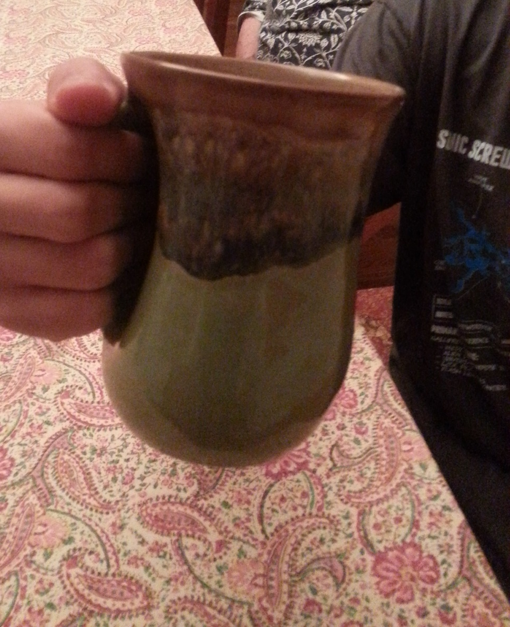
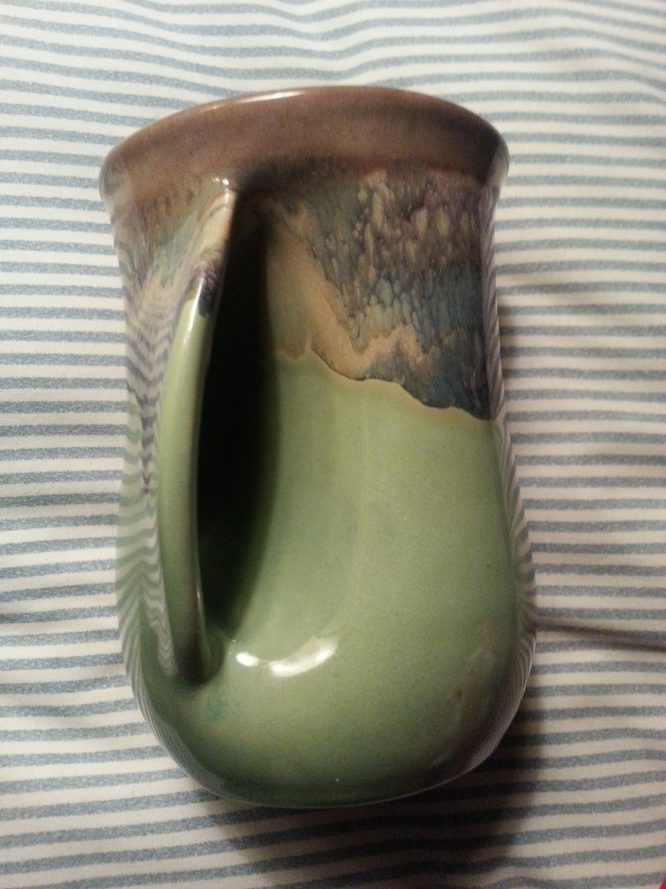
Useless “Ergonomic” Cup
By Daniel S

Slide 27
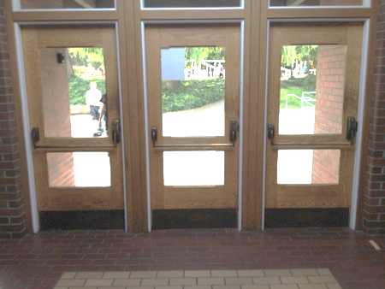
Gym Doors
By Alec G

Slide 28

The Decorative Pillow Bed
By Peter B

Slide 29
Low Fidelity Prototyping

Slide 30
Low Fidelity Prototyping
Published in “Prototyping for Tiny Fingers” in CACM by Rettig, April 1994
Low fidelity prototypes allows for quick exploration with minimal investment
Quickly sketched on paper, then evaluated.
Iterate and change sketches based on lessons learned.
Improves creativity and resulting design
From http://social.cs.uiuc.edu/class/cs465/lectures/lofidelity.pdf

Slide 31
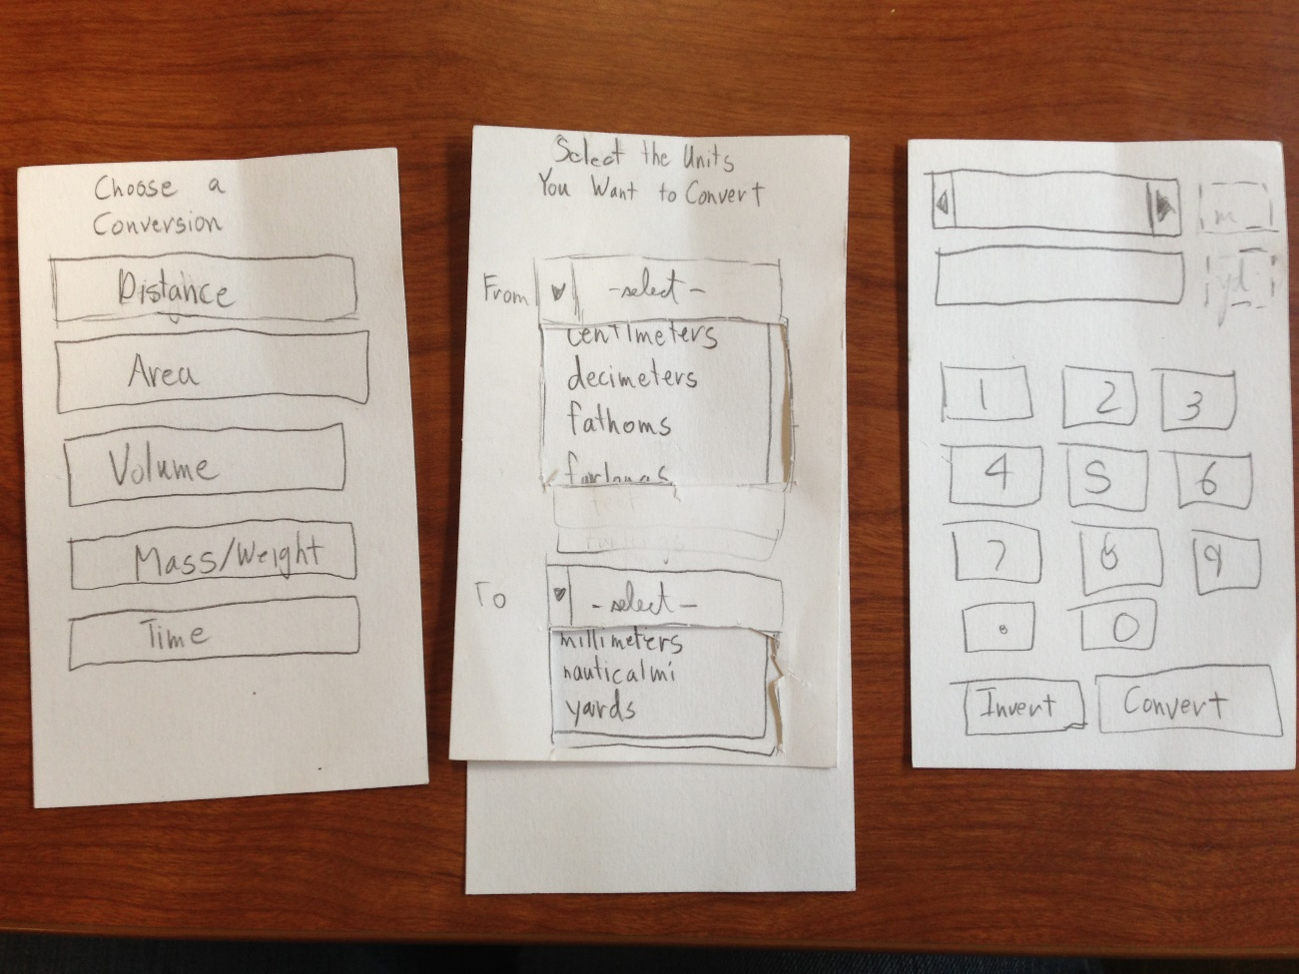
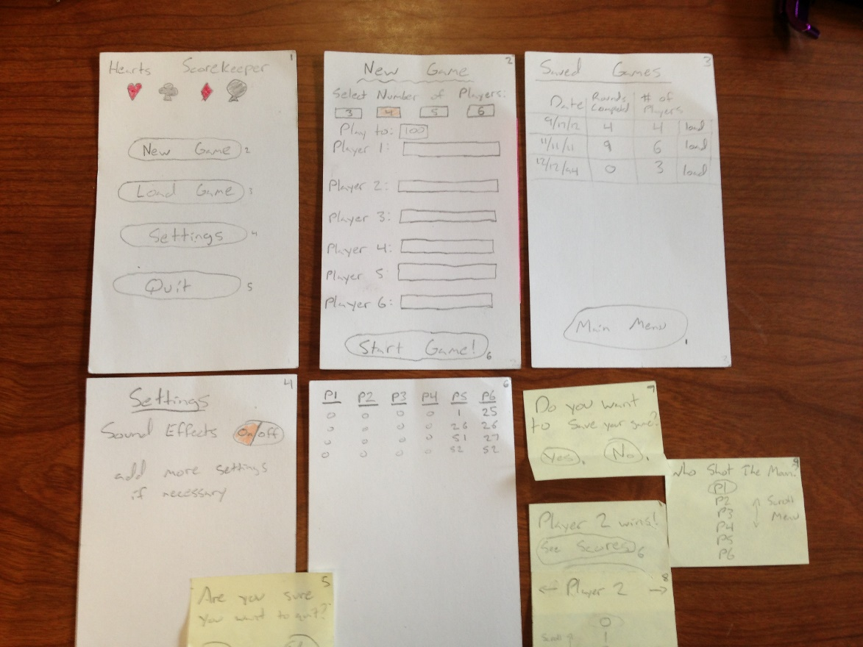
Notes:
Typical materials:
Paper: heavy paper for base interface screens
Overlays: show changes in content
Post-it notes: show changes in content
Adhesives: glue sticks, correction tape
Colored markers and pencils: enable highlighting, drawing in color
Scissors: cut content to size
Library: Pre-fabricate menus, buttons, tabbed panes, dialogs, etc.

Slide 32
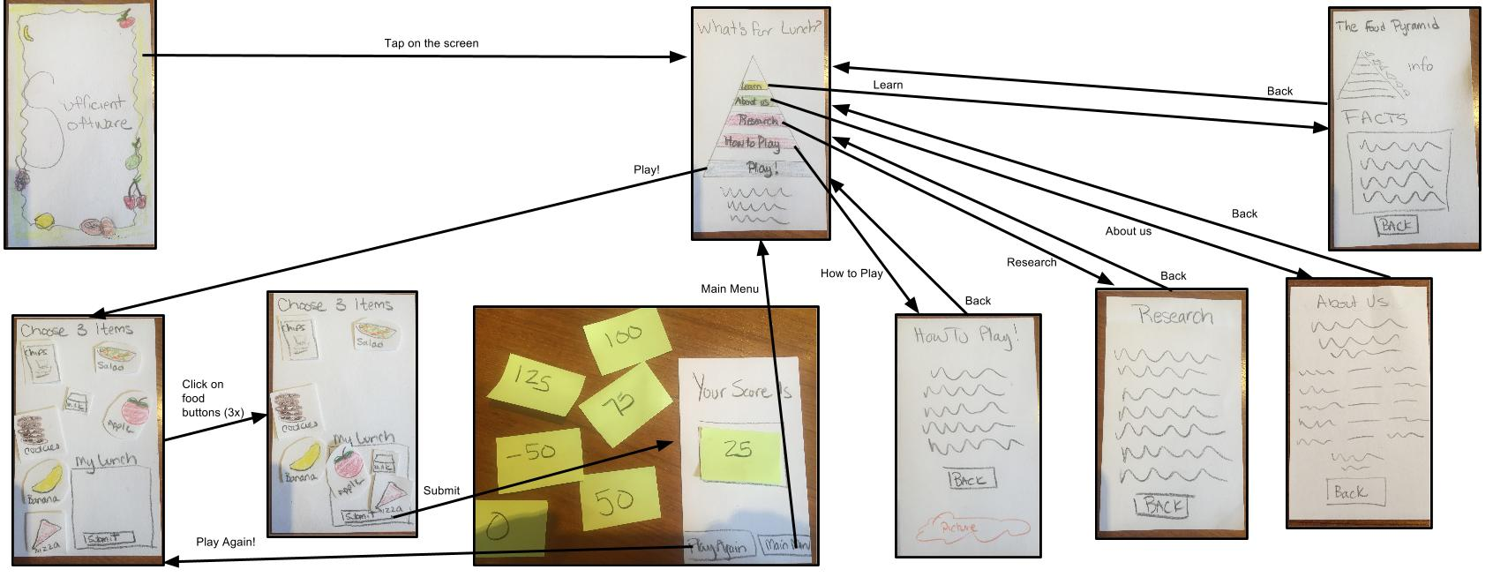
Video of the low fidelity prototype being tested

Slide 33
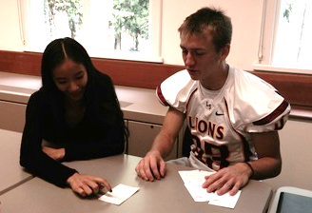
Prototype Evaluation
Evaluate how well users can perform tasks with your low-fidelity prototype
have a user perform a task with prototype
manipulate prototype to make it interactive
identify trouble points and solutions
revise prototype and perform again
This only works if your team’s goal is to improve the design, not defend it
From http://social.cs.uiuc.edu/class/cs465/lectures/lofidelity.pdf

Slide 34
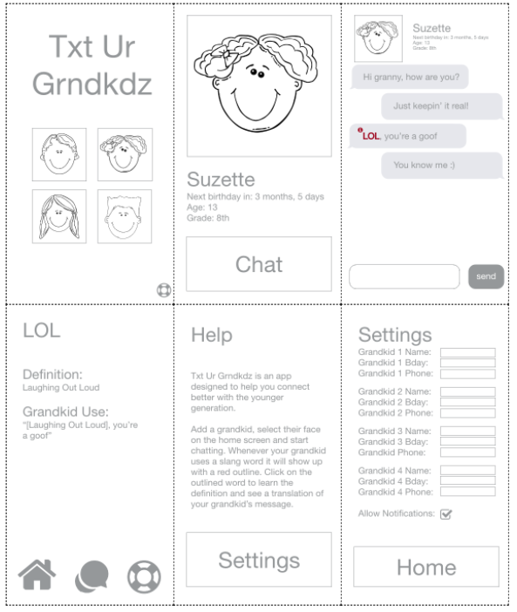
Notes:
User: https://docs.google.com/document/d/1IPu6hsHRui_ChXogq0nklAUuPUae2yx0RaADW9b4Nrs/edit
Computer: https://docs.google.com/document/d/1JOVsR0T5P7zQ6LdxfDjRSsX1EC8xk0TYZKe7X_GjYlk/edit

Slide 35
Benefits of Low-fidelity
Quick and cheap to build prototype
Communicates design concept and structure, can demonstrate interactions
Facilitates brainstorming and invites discussion
Enables early evaluation
Maximizes number of design refinements before you commit to code
Enables rapid and extensive exploration of the design space
From http://social.cs.uiuc.edu/class/cs465/lectures/lofidelity.pdf

Slide 36
“Homework”
Read about HCI in the CS Field Guide
Watch the rest of the video
Do some Contextual Inquiry
Find an object (not a computer program) that is poorly designed based on problems you see others having with it.
Come prepared to share:
What the object was…
Why it was poorly designed based on your observations?
Why do you think it was designed in this way?
What could be done to make this easier to use?
Create a low fidelity prototype for the project you are working on. Test it using the methods you learned here.

Slide 37
HCI Research at UW

Slide 38
HCI at UW
HCI at Allen School
HCDE
DUB
DUB Faculty Madness Slides

Slide 39

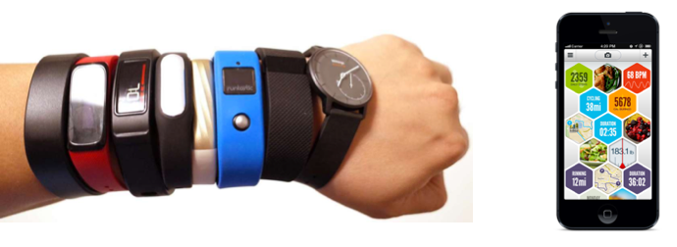
Tim Althoff, Assistant Professor, CSE
Research Areas
Data Science, Social Network Analysis, Natural Language Processing
Behavioral Data Science Group
Our research leverages detailed behavioral data from smartphones, smartwatches, and social interactions at the scale of billions of actions taken by millions of people. Our goal is to realize new types of scientific approaches that generate actionable insights about our lives, health, and happiness.
Recent projects include NLP for mental health and leveraging activity tracking for public health monitoring. More at http://althoff.cs.uw.edu

Slide 40
Extra materials

Slide 41
“The formulation of the problem is often more essential than the solution”
- Einstein

Slide 42
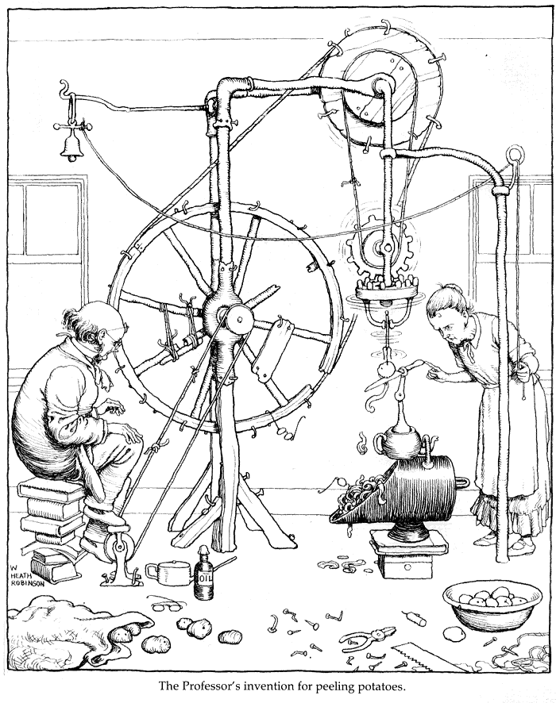
The Future
Computers do not need to be the way we see them today
Predict the future by inventing it.
Watch: Walter Cronkite's 1967 Vision Of The 21st Century Home Office

Slide 43
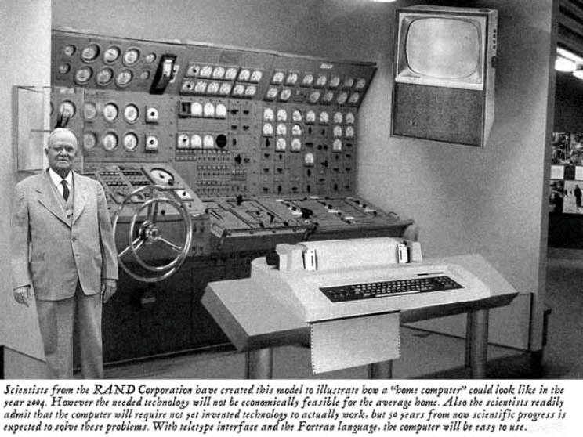
Popular Mechanics, 1954

